Slide 1
Lee SungHo
16102284
0
Supply Chain Management
M.S Son
Cpt. Korea
Need gf1
Y.H Kim
Dark Templar
Need gf 2
W.S Choi
Commando
Need gf3

Slide 2
Index
0
Company profile
Competitive strategy of supply chain
Value Proposition of the company
Impact on a supply chain: How they innovated the supply chain
SWOT
Future Prospect and suggestions

Slide 3
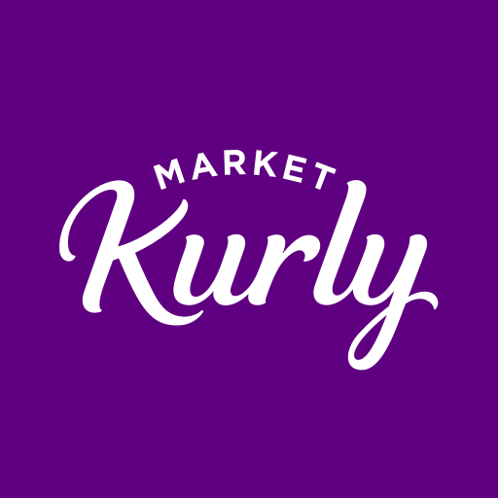
Company profile
1
As of May 20, company succeeded in attracting a total of 222.8 billion won in investment and was registered as a unicorn company.
According to data released by ‘WiseApp’, sales increased 126% from last year due to COVID-19.
Competitors include ‘Coupang(로켓 프레쉬)’, ‘Shinsegae(SSG)' and ‘Lotte(새벽에 ON)'.
<Market Kurly>

Slide 4
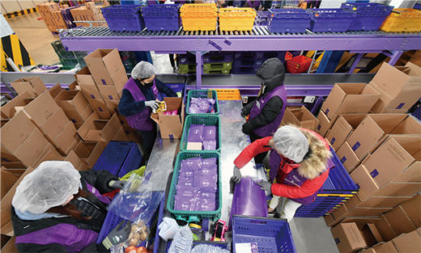
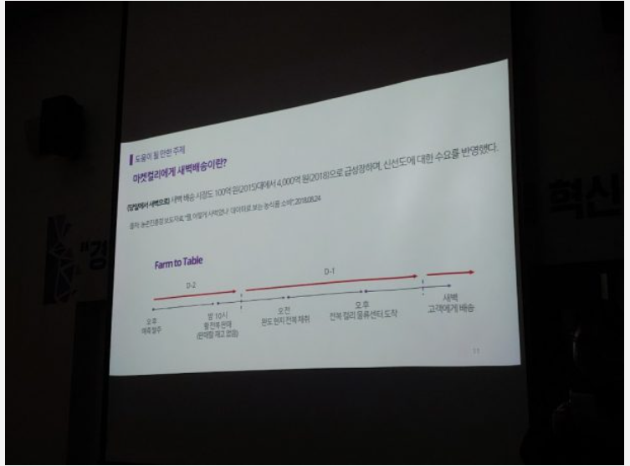
Competitive strategy of supply chain
2
The Picking Automation System is based on the Digital Assorting System (DAS) Unlike other competitors, (DPS).
Company can save time to fit in the distribution center.
The main product is a large quantity of small variety.
Company can flexibly respond to increase and decrease of supplies.
Using a data machine learning-based automatic ordering program, the company anticipates and orders customer orders even before production begins, and receives customer orders without inventory. Through this rigid ERP system, the 1% commodity disposal rate was recorded.
<DAS Picking>
<Predict System>

Slide 5

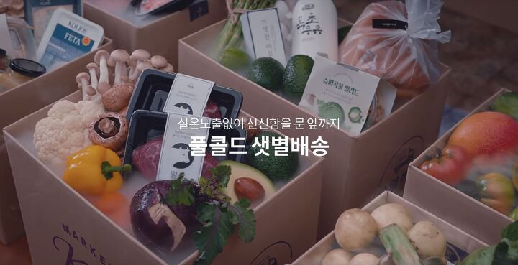
Value Proposition of the company
& How they innovated the supply chain
3
Delivery service early the next day for orders prior to 23:00, called ‘샛별 배송' (limited to metropolitan areas)
In order to attract fresh products, the distribution system was reduced for examining, and conducting transactions by visiting.
<Early morning delivery call ‘샛별 배송’>
To supply goods directly traded with good quality, use a full cold chain technique that manages at low temperatures from the moment of harvest in the production area.
<Full Cold Chain System>

Slide 6
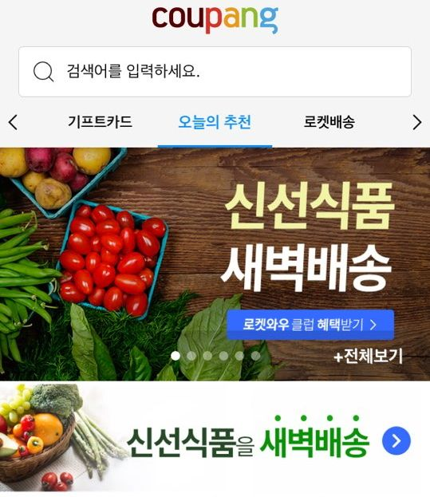
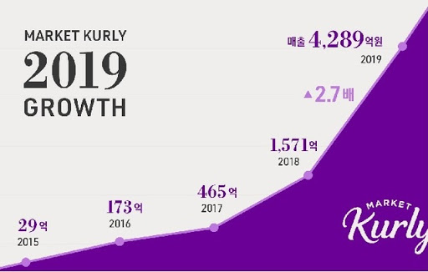

Impact on a supply chain
4
<Market Curly Growth Graph>
<SSG.COM ‘새벽배송’>
<Coupang ‘Rocket Fresh’>
Market Kurly revolutionized the logistics market with its ‘샛별배송＇ service described earlier. Due to the service, Market Kurly＇s sales in 18 years more than tripled to 157 billion won over the previous year and sales in 19 years to 428.9 billion won, 2.7 times larger than the previous year. Market Curly growth continues to grow steeply this year, especially due to COVID-19. The reason for this growth is possible because Korea has the first full cold chain system that keeps the entire distribution process from warehousing to delivery at a certain temperature. The cold chain system has expanded its application range in line with social, economic and environmental changes, becoming a new growth momentum for the refrigeration and refrigeration industries. Copycat of these systems, big companies such as ‘ShinSeGae' and ‘Coupang’ have jumped into the early morning delivery market by launching 'SSG' and ‘Rocket Fresh.'

Slide 7




SWOT
5
Strengths
Service is operated only in the metropolitan area
Sales increase but profits continue to decline.
No Cash-Cow
S
W
Weaknesses
The enterprise continues to grow.
The recognition of companies has increased through broadcasting and media.
T
Due to the advent of the Untact era, the delivery market has grown.
Consumers' needs for eco-friendly and healthy foods have risen.
O
Threats
Opportunities
There are a lot of competitors.
The portion of subcontractors(‘팀프래쉬’) is large

Slide 8
Future Prospect and suggestions
6
Create a new fresh food hub center in conjunction with the local supermarket
: As Amazon acquired ‘WholeFood' to establish a foothold in fresh food delivery, ‘Marketcurly’ will unite with 20,000 local supermarkets nationwide in the 42 trillion market to foster the power to resist large companies
=>By strengthening the interface with the 3PL company (local supermarket) operating system and its system, the company prepares items to be received and shipped in advance during the day by predicting data that was normally sold in the region. In addition, joint purchases with companies can reduce operating costs by lowering the unit price of goods.

Slide 9
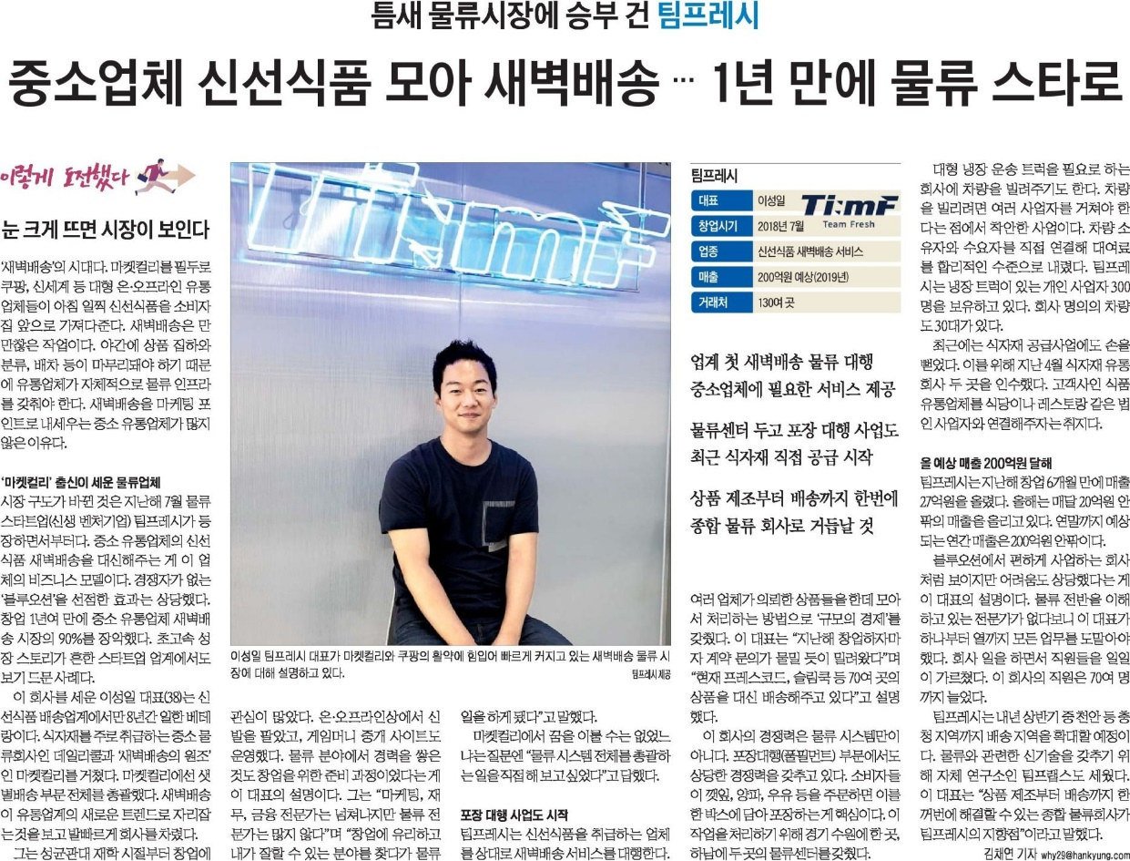
Future Prospect and suggestions
6
2. Company need to get out of its heavy reliance on ‘팀프레시’ company
: ‘팀프레시’ is responsible for much of Market Kurly's fresh food delivery. Although the CEO is from the company, he is now in a friendly relationship, it is necessary to internalize the cold chain full-filament system as ‘Market Kurly’ will have a significant target when the competitor takes over the company.

Slide 10
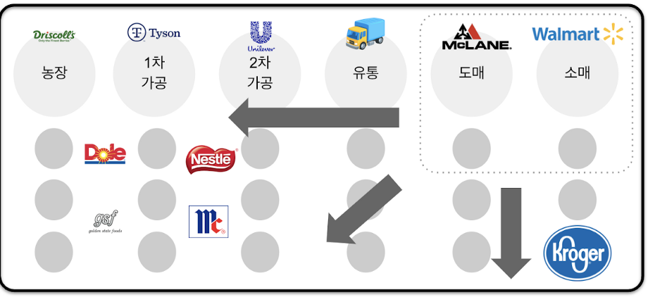
Future Prospect and suggestions
6
3. Introduction of Supply Chain System Using Blockchain
: In order to further refine the demand forecasting system, which is currently being used well, the company introduces block chain technology to secure high-quality data, increasing the inflow of systems from franchises and increasing the missing data.
=> This makes it easy for farmers and small and medium-sized enterprises with poor ERP systems to enter company ERPs.
<Example of WallMart’s SC using block chain>

Slide 11
https://ilyo.co.kr/?ac=article_view&entry_id=338697 http://fpost.co.kr/board/bbs/board.php?bo_table=fsp2&wr_id=11 https://magazine.hankyung.com/business/article/2019041501220000171 https://logipress.tistory.com/662 http://www.investchosun.com/2019/06/25/3238669 https://byline.network/2019/09/23-59/
Reference
7

Slide 12

Reference
7

